Slide 1
Time Series Clustering Exploration
with DTW and SAX
Final Project
Srini Katakam and Jonathan McNutt

Slide 2
Agenda
Introduction
Preprocessing
K-means clustering DTW
K-means clustering SAX
Conclusions
Future research

Slide 3
Introduction
Time series clustering is not trivial
What distance metric should be used?
How to assess the results?
How can DTW K-means be done faster (quadratic time)?
Could stocks be grouped together in a new/better way through time series clustering (as opposed to expert humans) and gain a competitive edge over the market?
We will try to approach this problem by using a different algorithm called SAX.
We will use TF-IDF to determine the importance of symbols in a time series and later perform K-Means cluster.

Slide 4
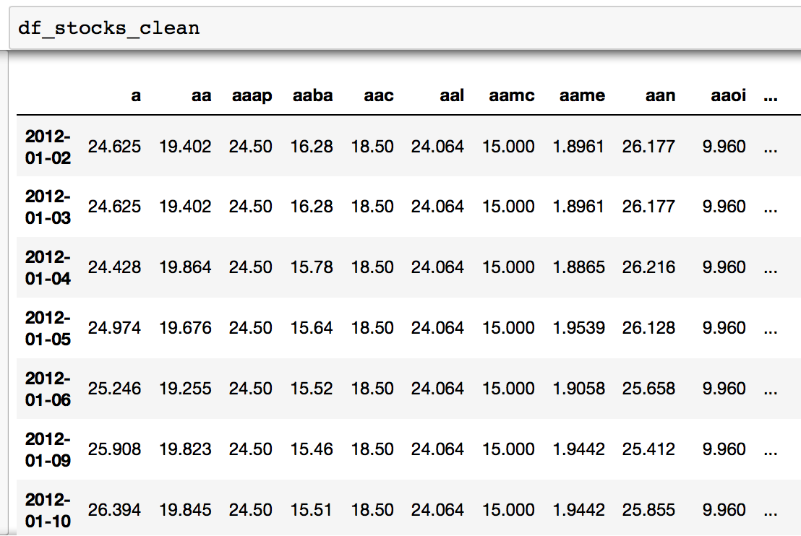
Preprocessing the Kaggle stocks data
Took daily close prices of almost 7,000 stocks from 2012-2016 (roughly 1,300 trading days) from a Kaggle dataset
Cleaned data by backfilling null values (where a stock did not yet exist, perhaps)

Slide 5
K-means clustering: DTW vs Euclidean distance
Tslearn⁷ package further processing:
Transposed the data frame and converted to a matrix
Transformed the time series within the matrix using a scaler with mean of 0 and standard deviation of 1
The tslearn package also converts the 2-D matrix into a 3-D array (n, s, d), where n is the number of time series, s is the size of the time series, and d is the number of features, or dimensions of the time series.

Slide 6
K-means clustering: DTW vs Euclidean distance
Ran tslearn function ‘TimeSeriesKMeans’ with 3 different distance metrics:
Dynamic Time Warping Barycenter Average (DBA)
‘Soft’ DTW
Euclidean
Observations:
DBA DTW did not finish after several hours so we stopped it.
‘Soft’ DTW also took nearly an hour to complete.
Euclidean was very fast but can only compare same-size time series.
We decided to reduce the size to only 1 year and number of stocks to 100 and 500.
We tried clustering with different hyperparameters and compared results

Slide 7
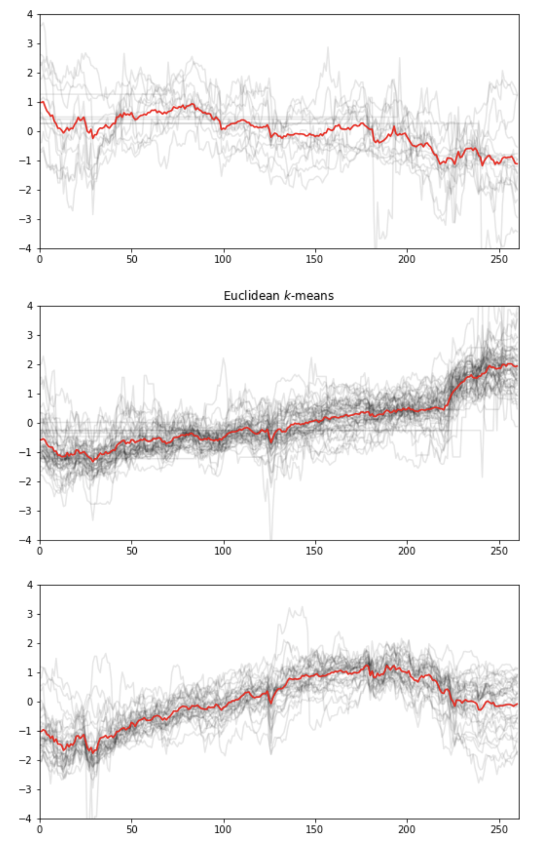
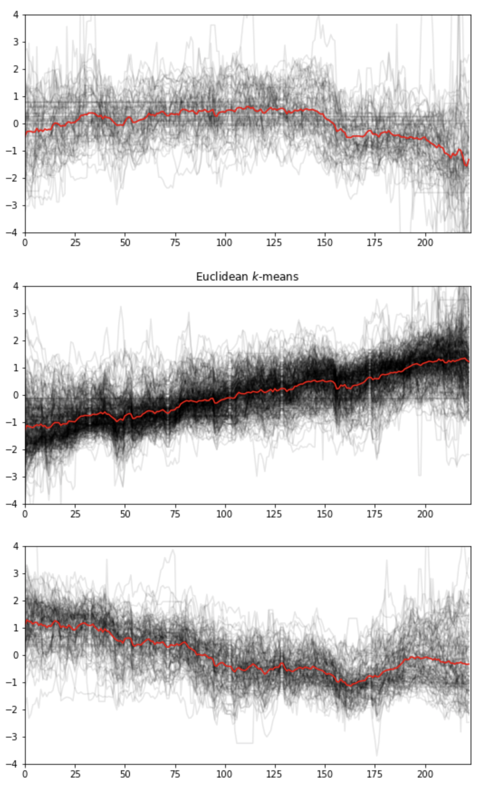
Euclidean distance K-means clustering
Left - 100 stocks from 2016 K-means euclidean
Right - 500 stocks from 2017 K-means euclidean

Slide 8
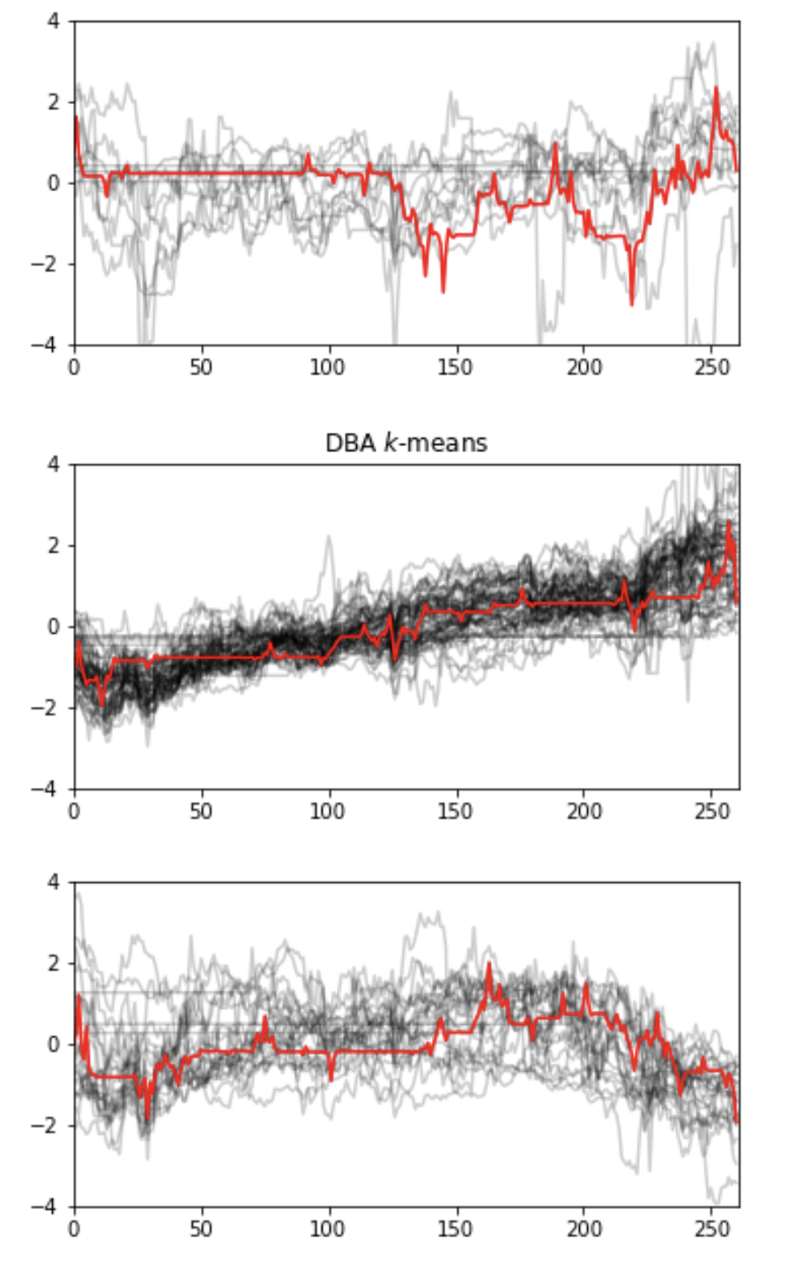
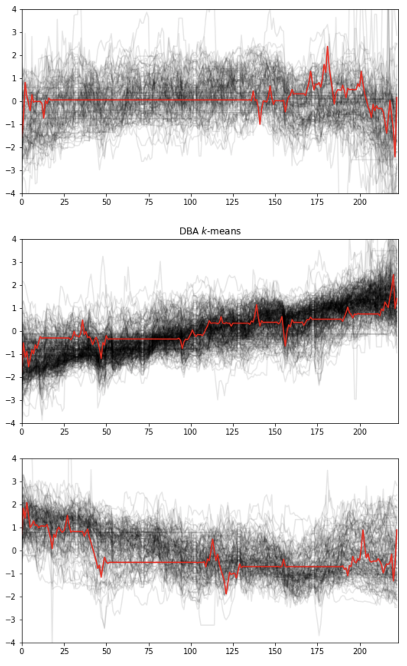
DTW Barycenter Average (DBA) K-means clustering
Left - DBA DTW k-means 100 stocks from 2016
Right - DBA DTW k-means 500 stocks from 2017

Slide 9
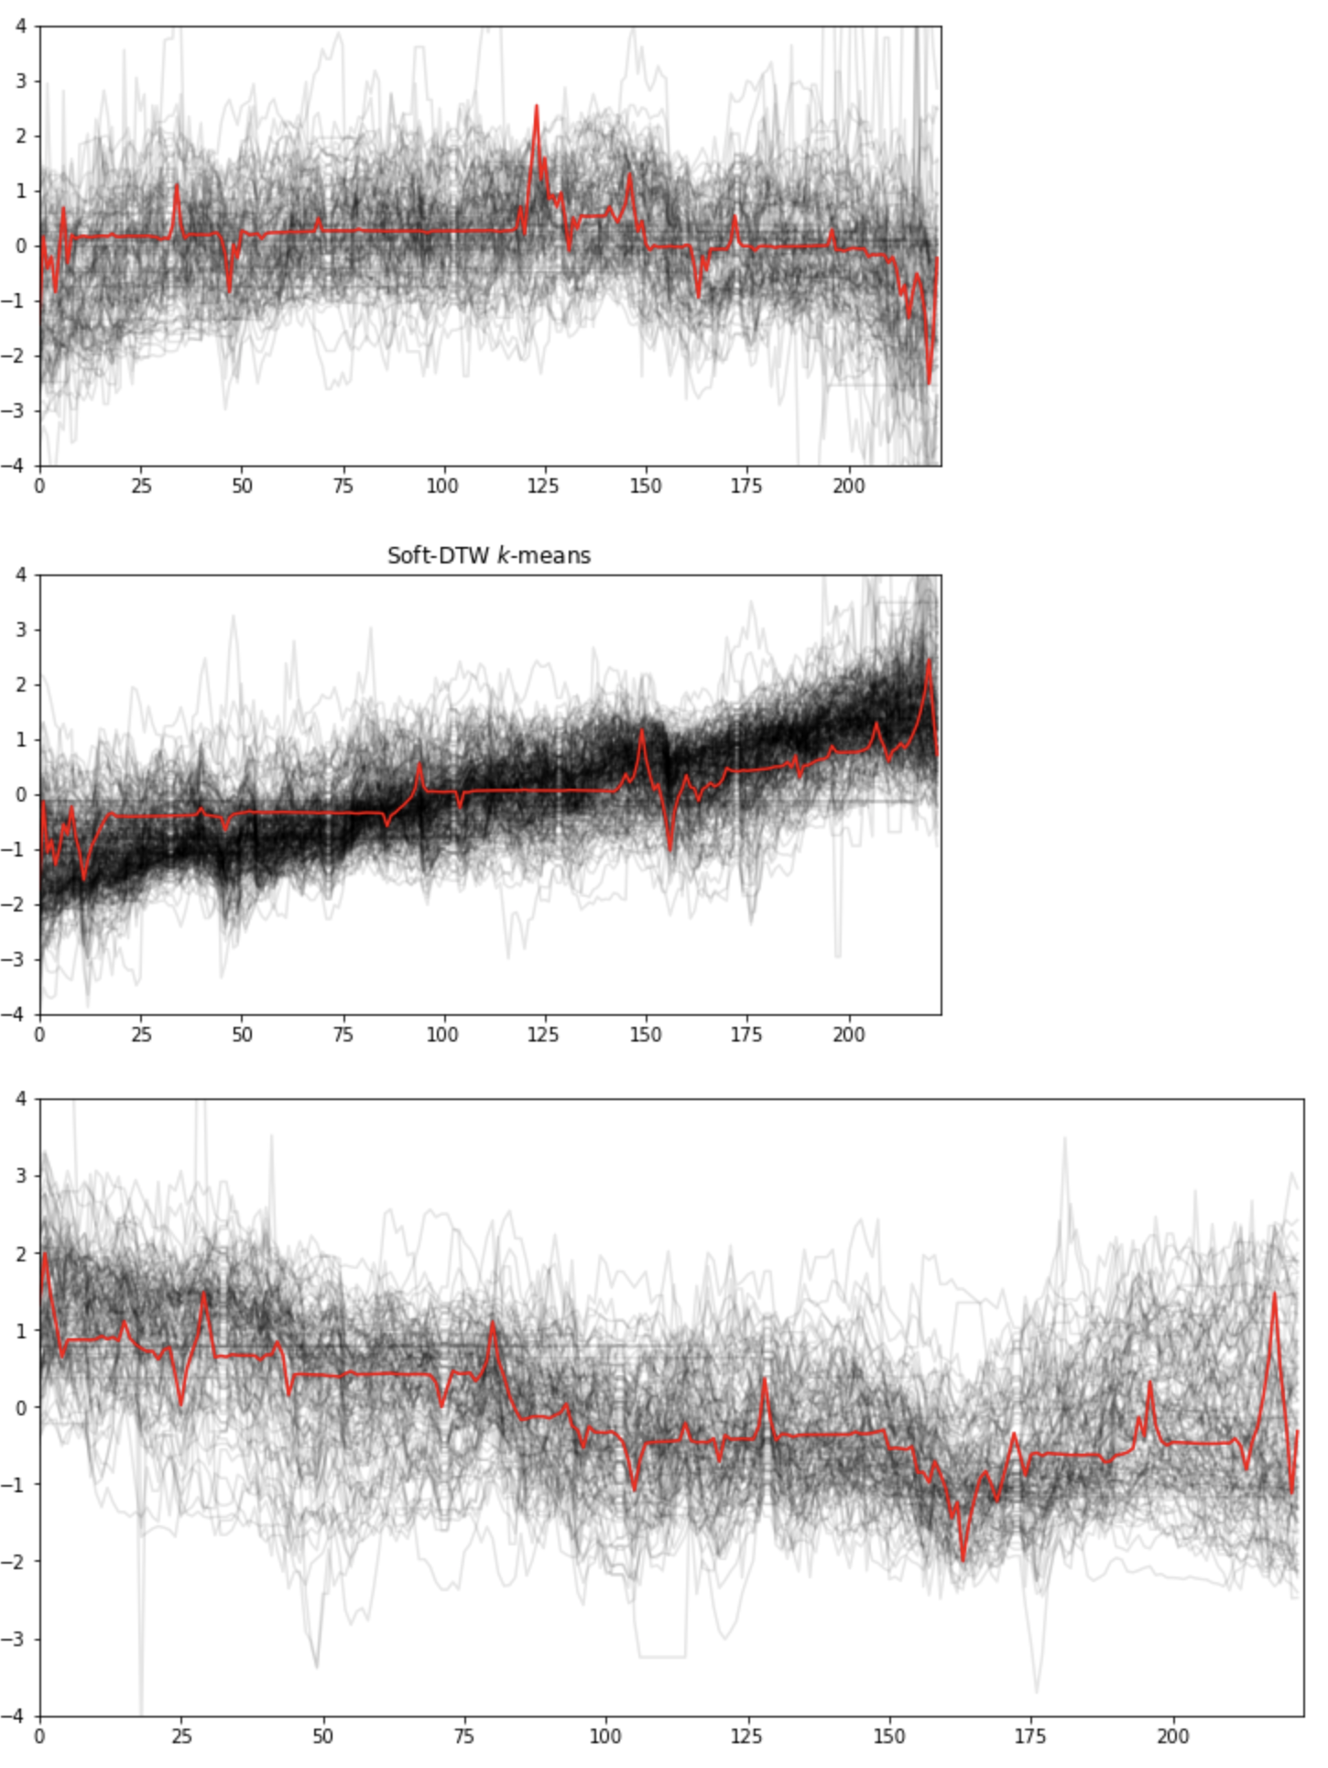
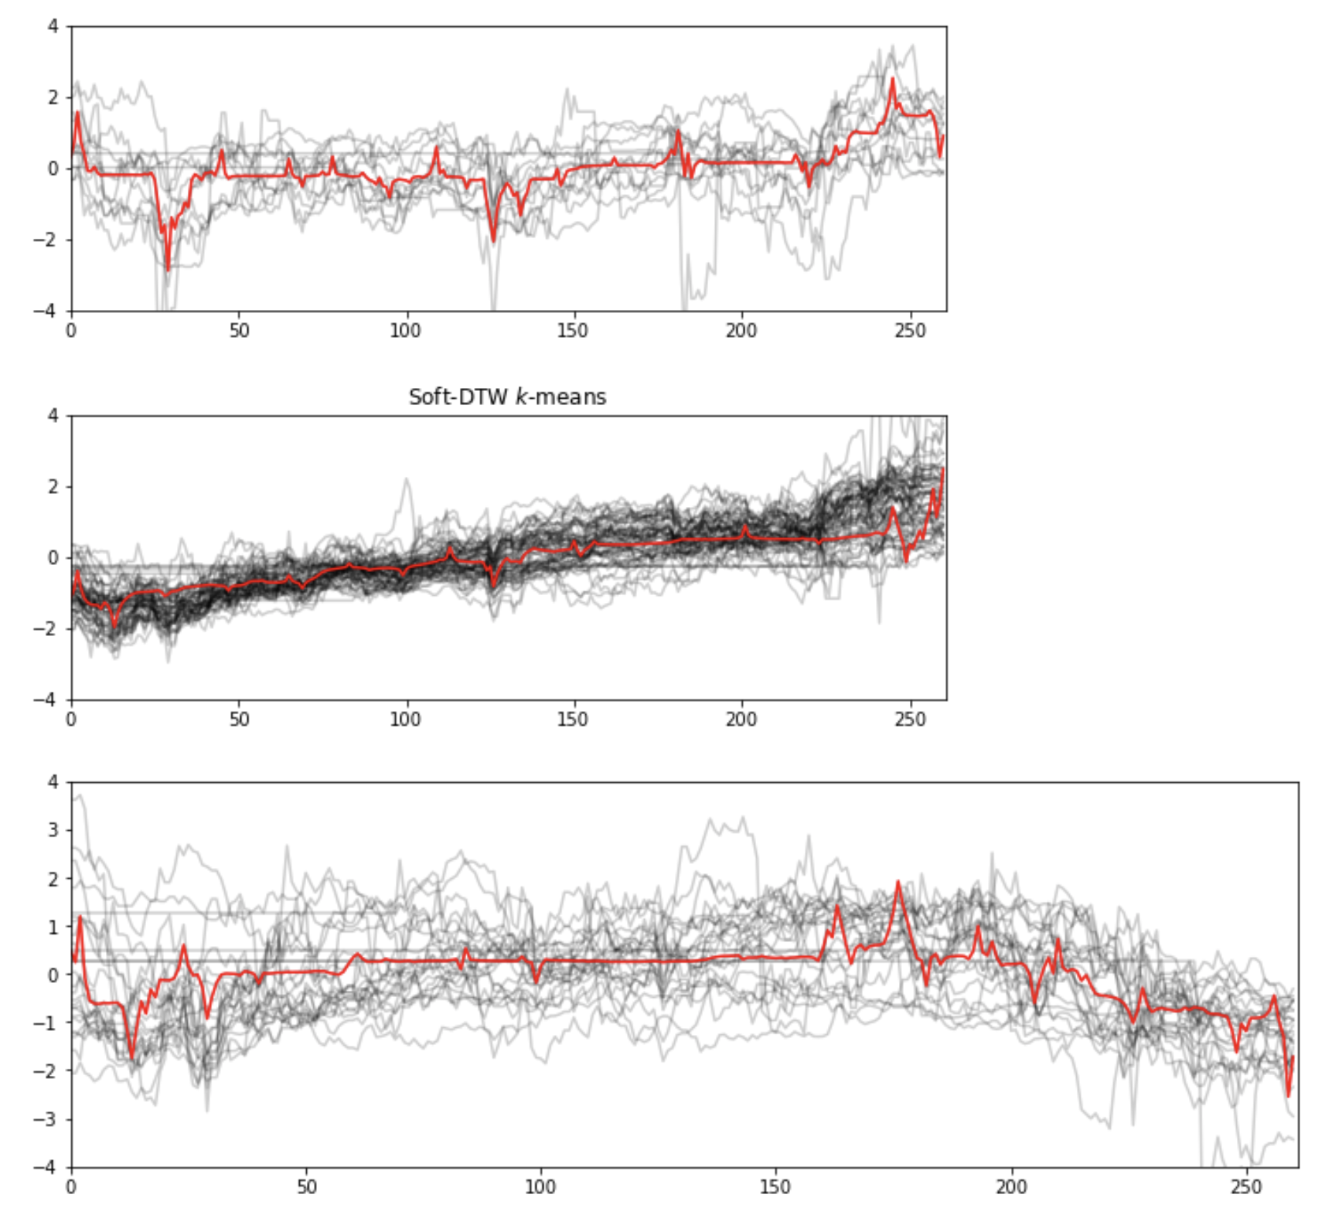
Soft-DTW K-means clustering
Left - 500 stocks from 2017
Right - 100 stocks from 2016

Slide 10
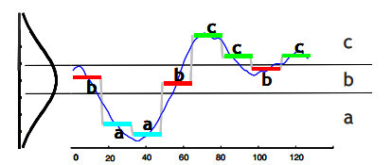
What is SAX?
Symbolic Aggregation ApproXimation
Algorithm to transform an input time series into a strings.
Reduces the dimensionality
Approximates to lower bounding of Euclidean Distance

Slide 11
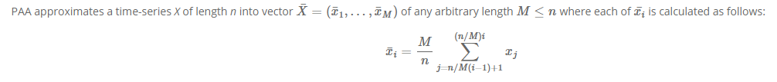
How to obtain SAX?
Step 1: Reduce the dimensionality by PAA (Piecewise Aggregate Approximation)
Step 2: Normalize the PAA’ed time series to have a Gaussian Distribution and determine cut-points that will produce a equal-sized areas under normal curve
Step 3: Assign alphabets to the above areas and the corresponding time series resulting in string representation, ex: baabccba
We used pysax², a python implementation of SAX which has functions for all the above steps.

Slide 12
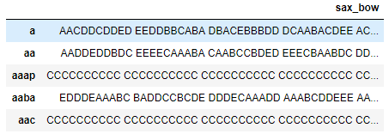
Clustering using K-means
Each time series is converted into list of words called Bag of words.
We then convert these Bag of words to TF-IDF vectors and perform clustering using K-Means with K=15.
Later we convert the distance matrix into a 2D array using Multidimensional scaling.
Visualizing the plots.

Slide 13
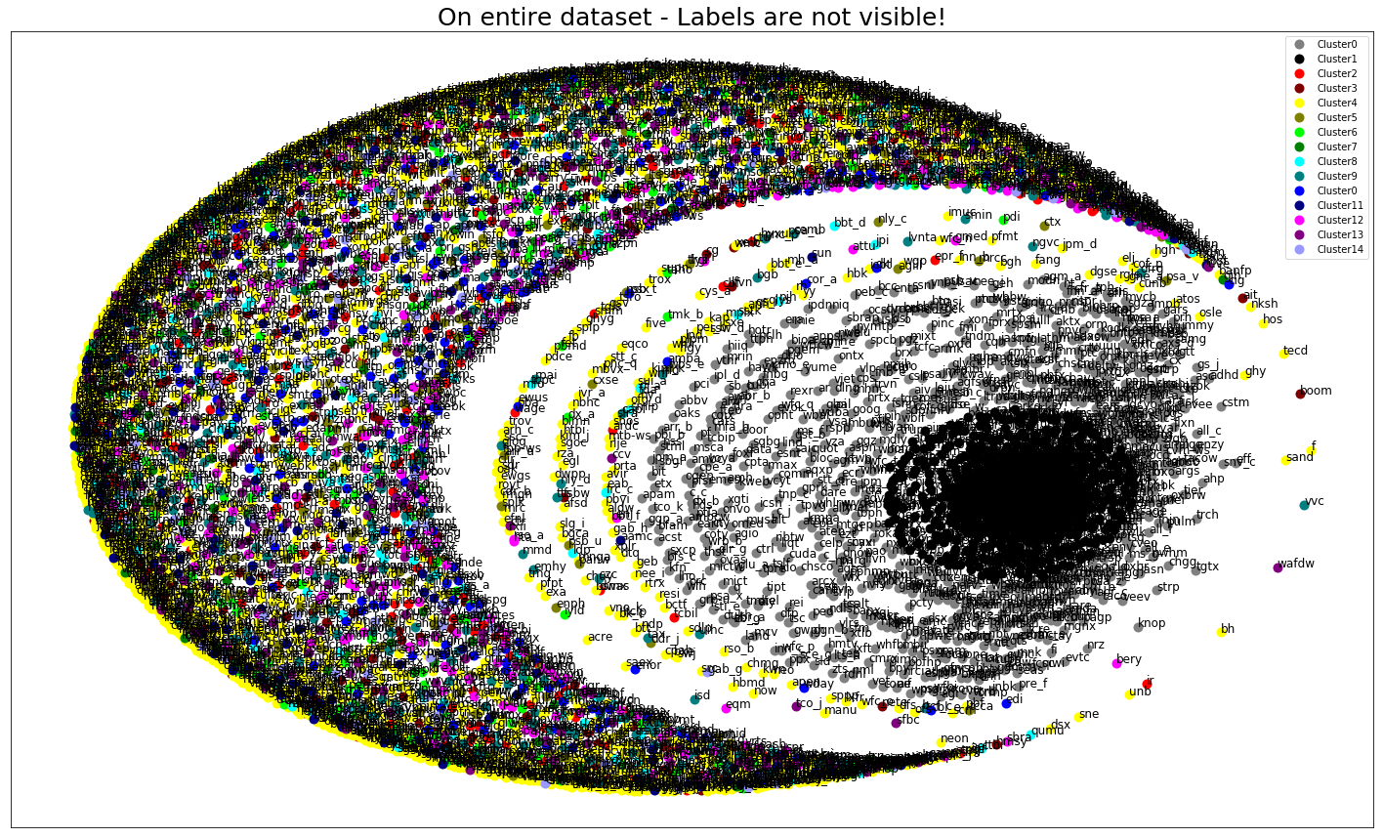
Visualization of entire dataset (~7000+ stocks)

Slide 14
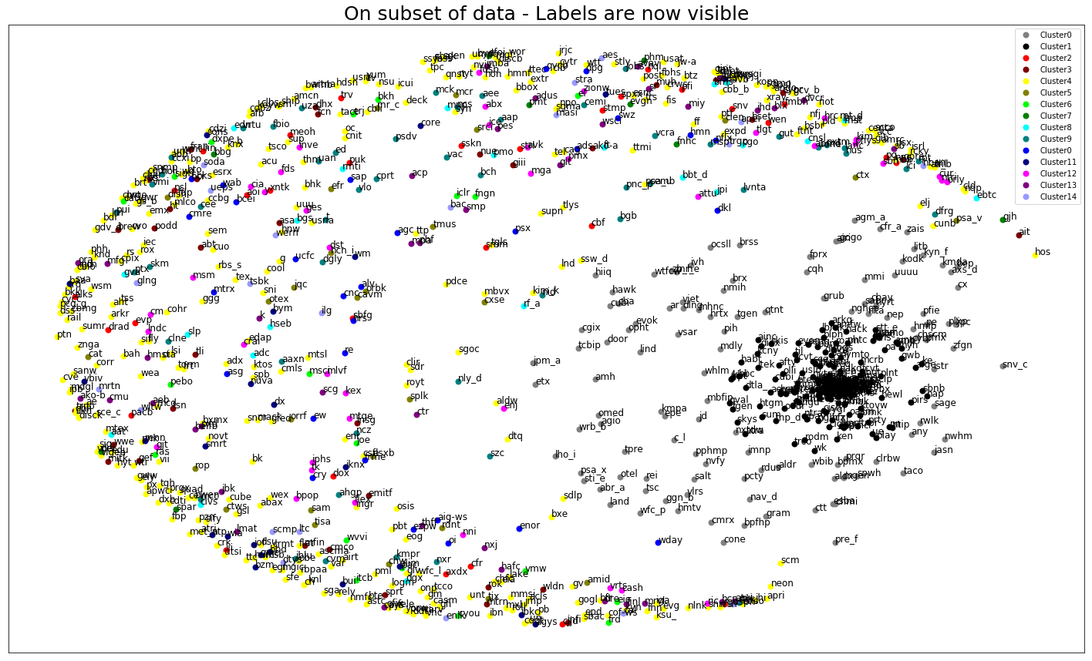
Visualization of partial dataset (~1000 stocks)

Slide 15
Conclusions
DTW has been the standard due to its flexibility and accuracy but is computationally expensive.
DTW clustering results improved with more stocks data.
SAX approach is faster, was able to process entire dataset within couple of mins (depending on window size and stride - hyper parameters).
Because of the approximation, we could lose some valuable info but the performance is the key with SAX approach.
Another approach that we wanted to try was Matrix Profile which is more recent algorithm and very efficient way of finding motifs and anomalies in time series.

Slide 16
References
http://www.cs.ucr.edu/~eamonn/SAX.htm
https://github.com/dolaameng/pysax
http://brandonrose.org/clustering
https://www.kaggle.com/borismarjanovic/price-volume-data-for-all-us-stocks-etfs
https://jmotif.github.io/sax-vsm_site/
http://www.cs.ucr.edu/~eamonn/MatrixProfile.html
http://tslearn.readthedocs.io
http://perso.eleves.ens-rennes.fr/~xshan192/doc/time_series.pdf

